Slide 1
Spherical Microwell Arrays for Mesenchymal Stem Cell Cultures
KUO, Hsu-Ting
Supervisor: Keng-hui Lin
Institute of physics

Slide 2

Motivation
In Lin’s lab, the former postdoc, Jonny Huang, developed a spherical microwell arrays as a novel 3D culture method.
Data shows that the self-renewal ability of REF52 cell decreases under 3D confinement
40 μm
60 μm
80 μm
100 μm
Get rid of this
Rat embryonic fibroblast REF52

Slide 3
Original protocol
MOLD 1
Step 1: Create an array of micrometric cylindrical holes on PDMS
Step 2: Manually placed glass microspheres one by one onto the cylindrical holes
Step 3: Pour fast curing silicone on PDMS
MOLD 2
Step 4: Peel off the microspheres
Step 5: The second silicone template is applied with an off-the-shelf two-part epoxy resin and evenly appended to a glass-slide
MOLD 3
→ Step 6: Obtain monolithic epoxy microsphere mold

Slide 4

Step 7: Using the mold to make PA gel
Step 8: Sterilization process (UV light)
Step 9: Protein coating on the PA gel
ECM proteins
Step 10: Peal off extra protein
Pressure
top ECM removal
aldehyde-coated slide
overnight

Slide 5



Drawback of the Original Protocol
10 steps
3 different molds
involved
Time consuming:
around 3 days
Labor consuming

Slide 6
Objective
Our goal is to:
Simplify the protocol of making 3D cell cultured platform
Observe the change in self-renewal ability of mesenchymal stem cells (MSC) under 3D confinement.

Slide 7
Simplifying steps of making the 3D cell cultured platform
Simplify the procedure of beads placing
Avoid the step of pealing off extra protein
Microspheres coating with ECM proteins

Slide 8
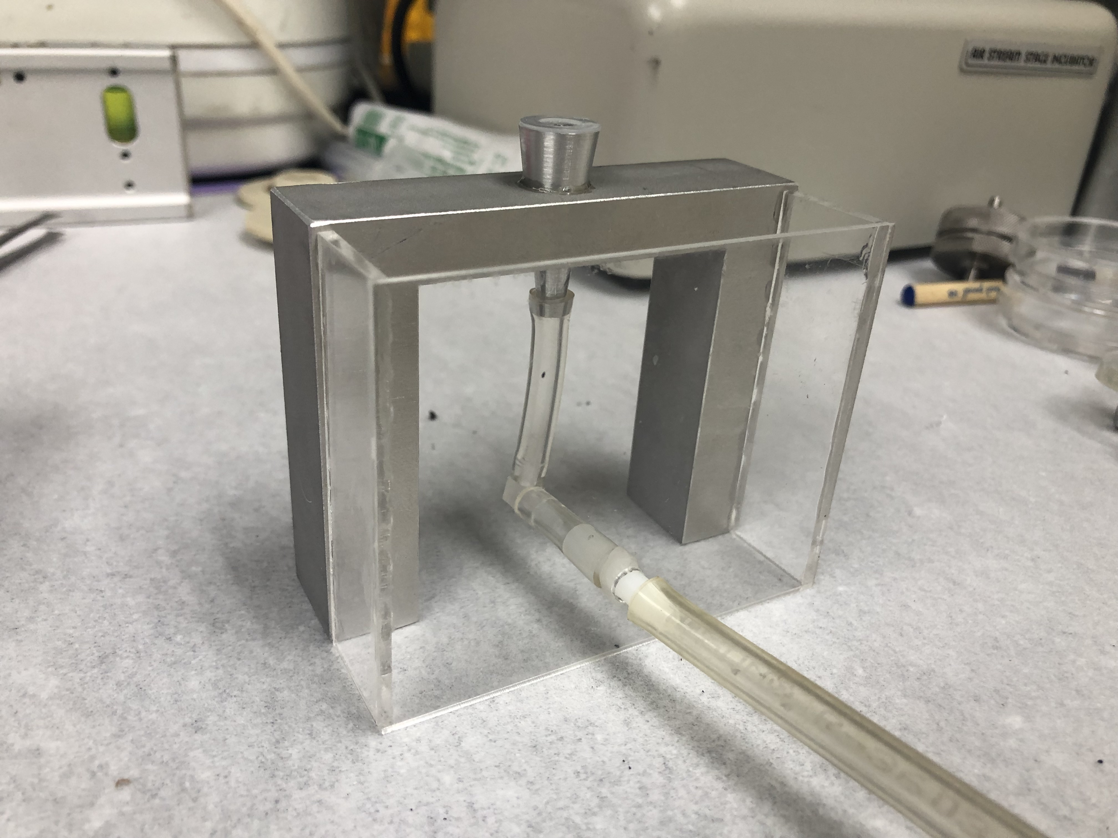
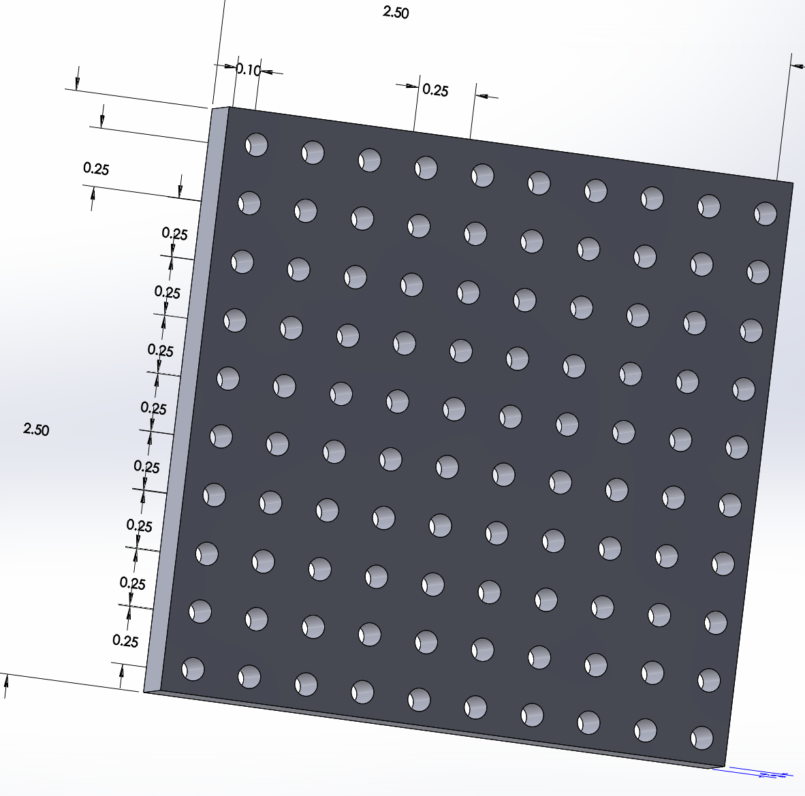
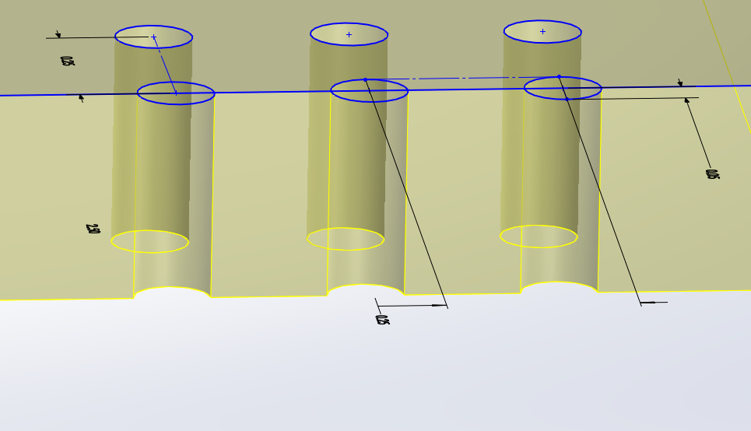
Placing beads on an array of through holes
To achieve this purpose, I designed a chuck to hold the hole arrays.

Slide 9
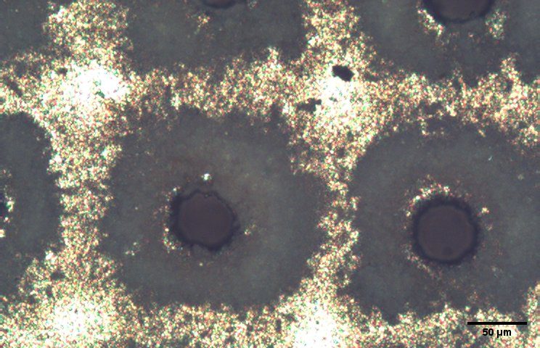
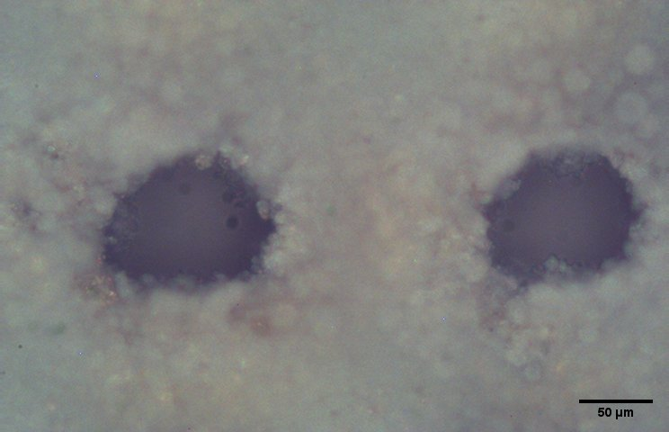
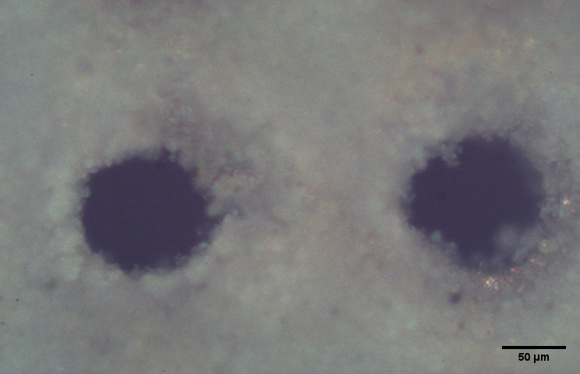
Making Hole Arrays
Custom-made by laser hole drilling.
52um
83um
83.95um
113.25um
52um
106.67um
2’’ si wafer
Thickness: 275um
4’’ si wafer
Thickness: 400um
5’’ si wafer
Thickness: 500um
Problem: Non-spherical holes. The vacuum leaks when the spherical spheres sit on top.

Slide 10
Solution:
Use glue to keep beads in place
glue

Slide 11
Solution:
Use glue to keep beads in place
glue

Slide 12
Avoid the step of pealing off protein
Coat protein on beads beforehand
Cover glass
PA gel
glue

Slide 13
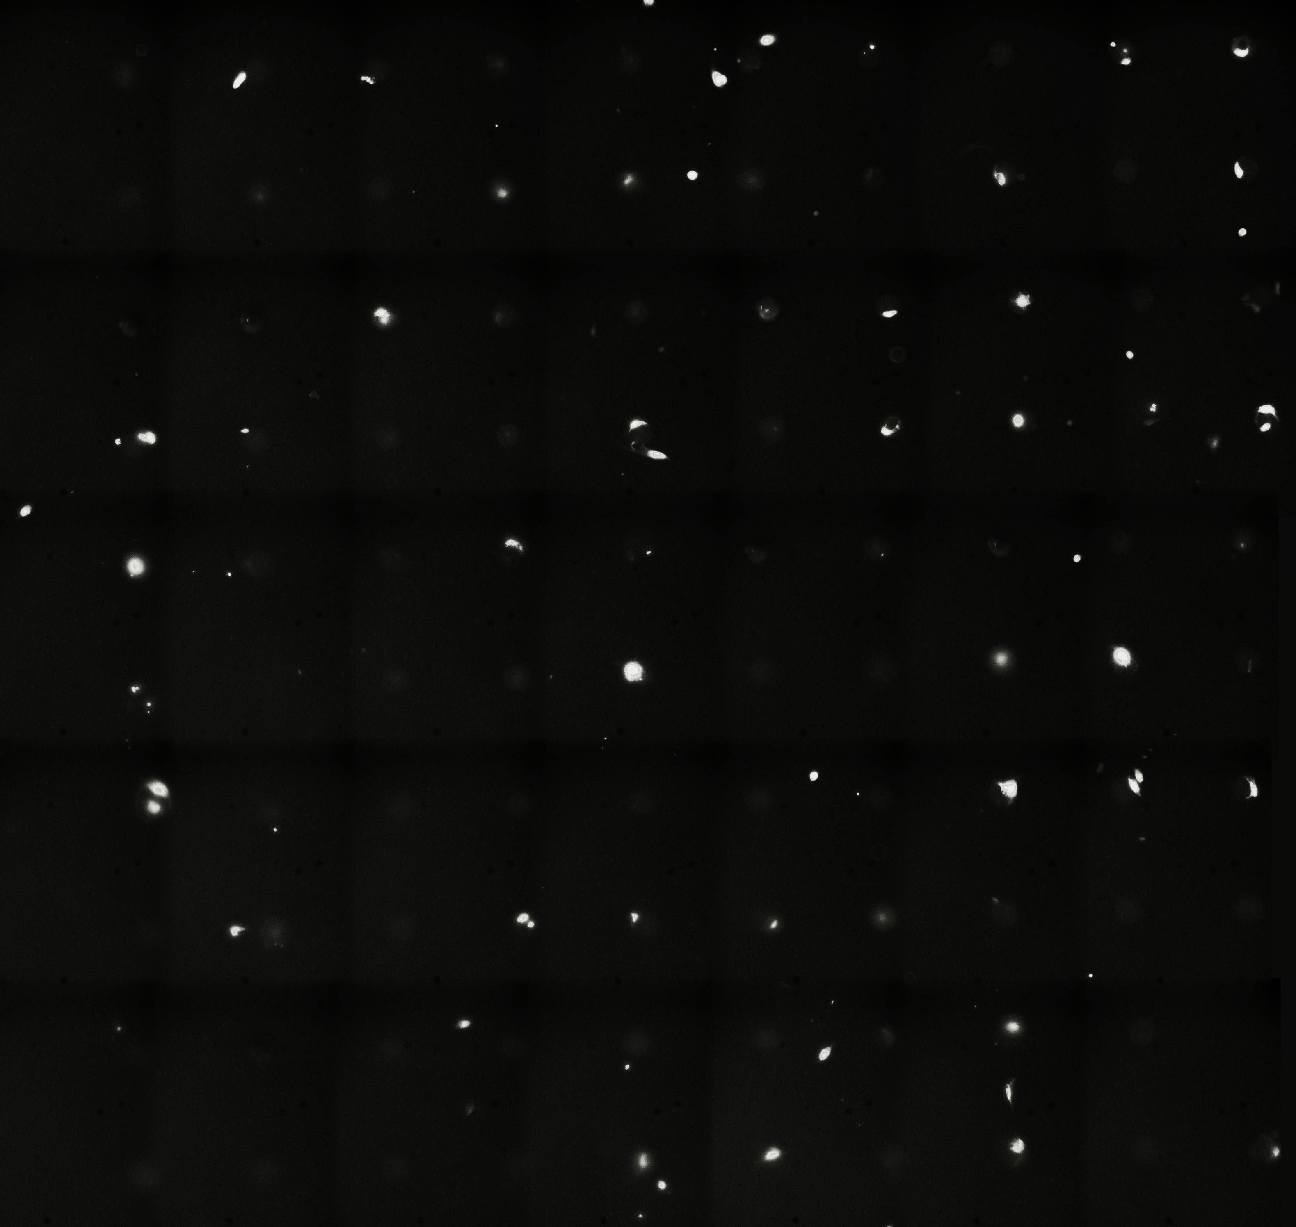
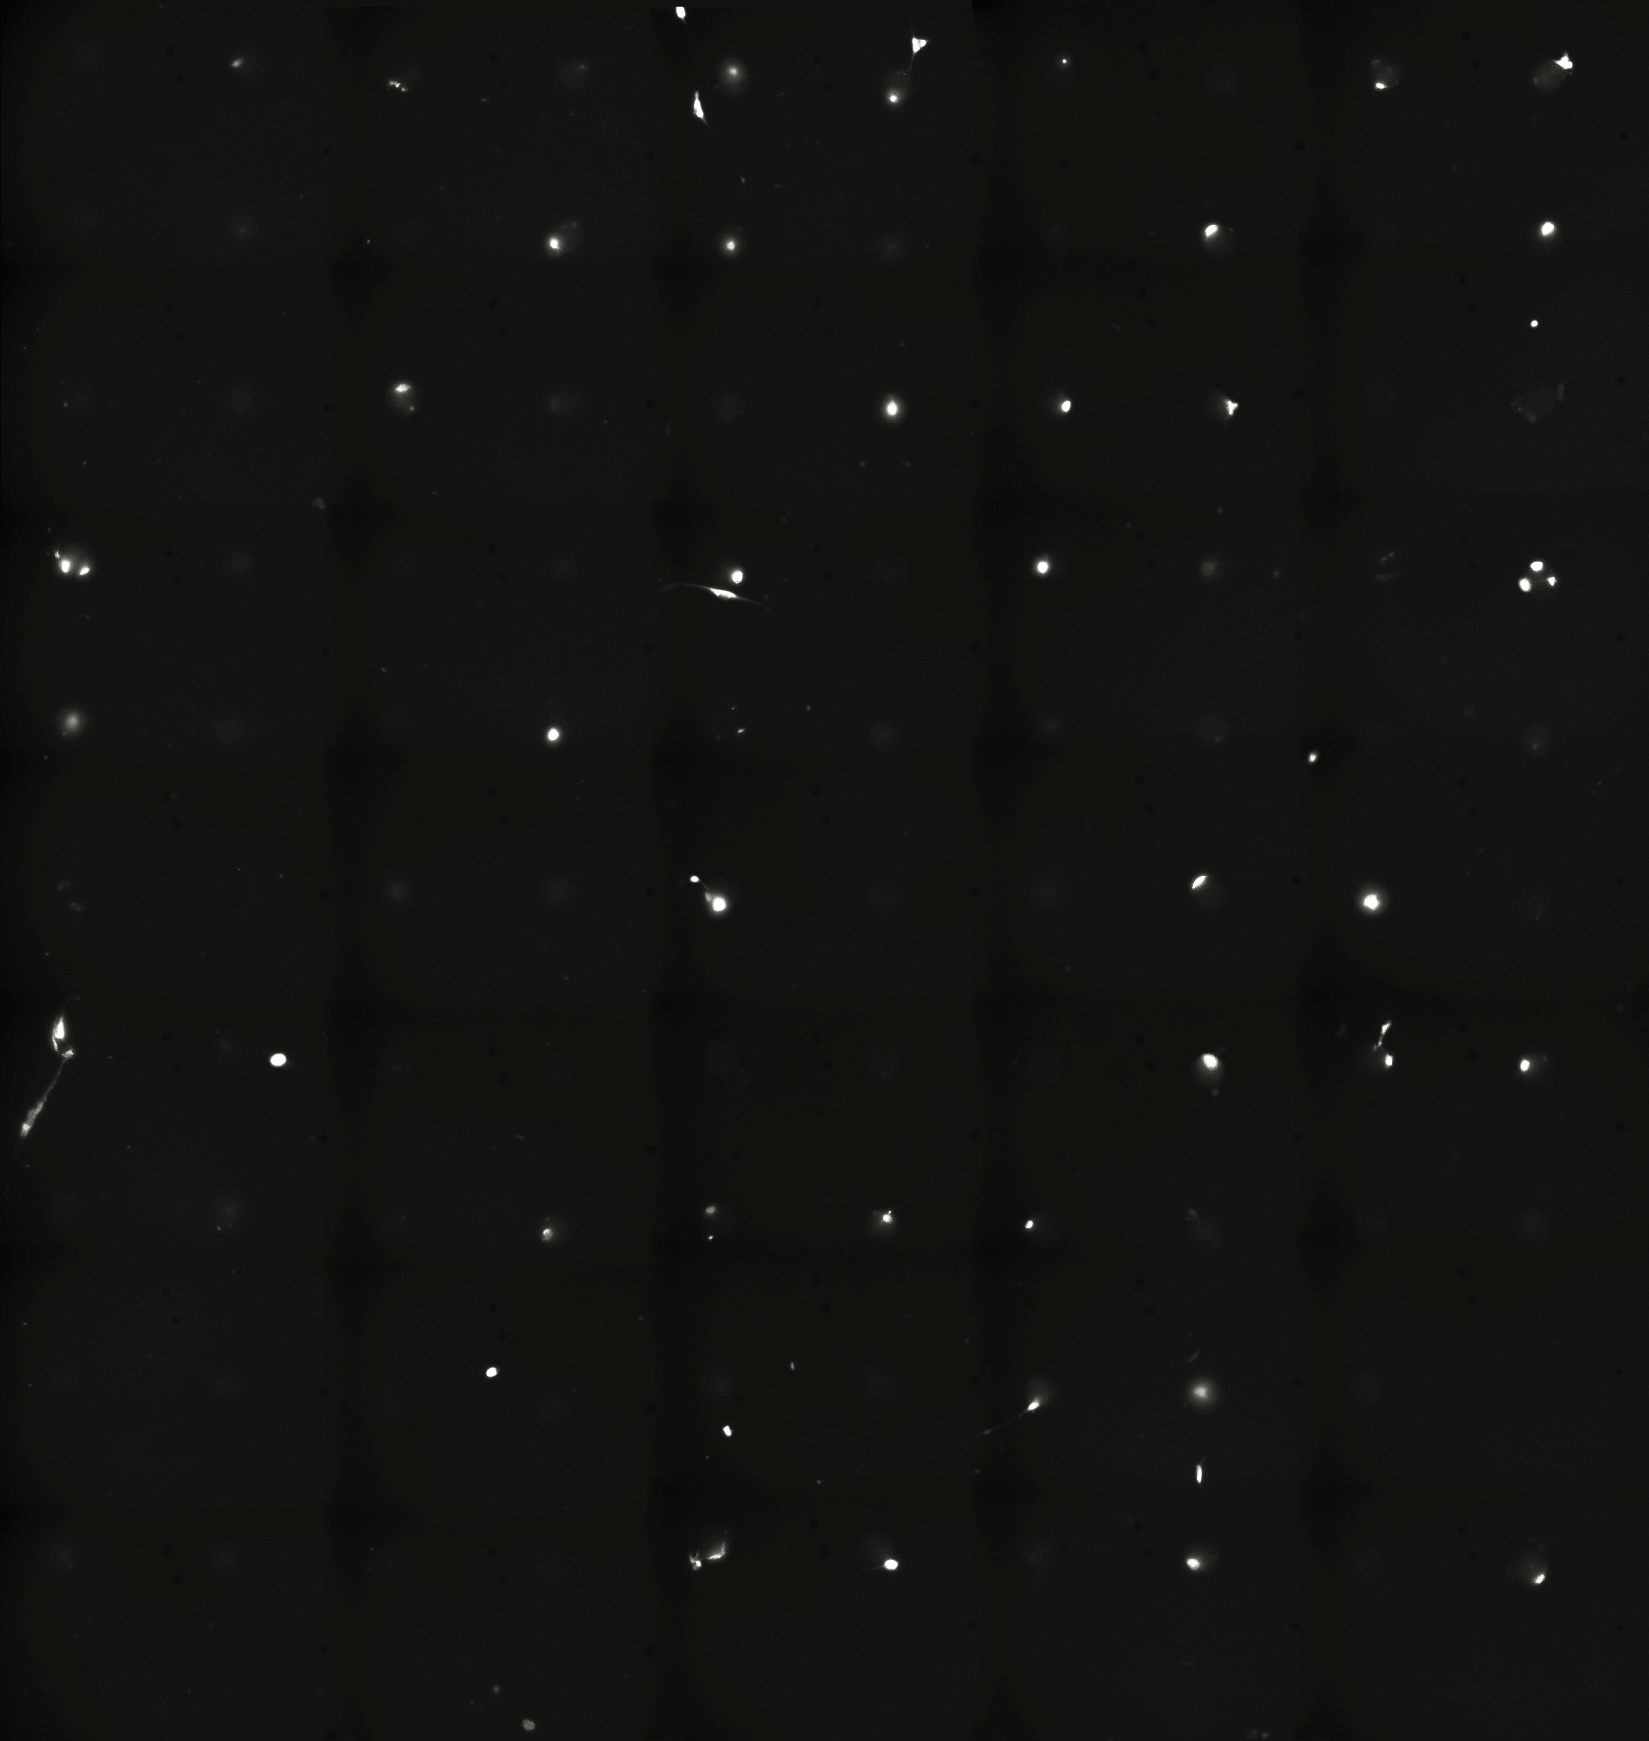
MSC grown in 60 mm pores
2019/08/15 Day0
2019/08/19 Day3
Single cell in pores undivided :
N: 38 out of 38 → 100%
20x TRITC Fluorescent dye: CellTracker

Slide 14
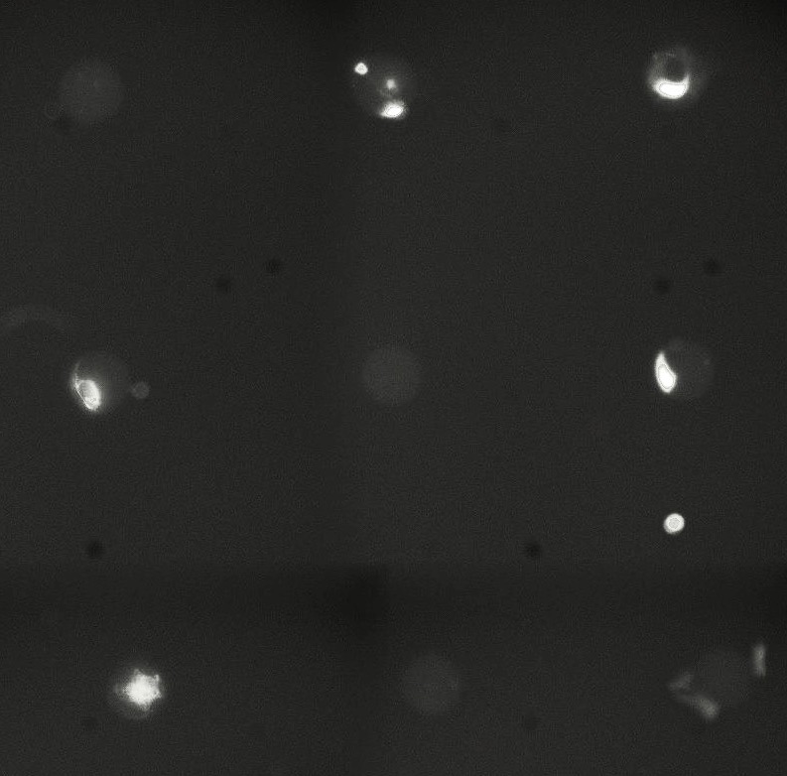
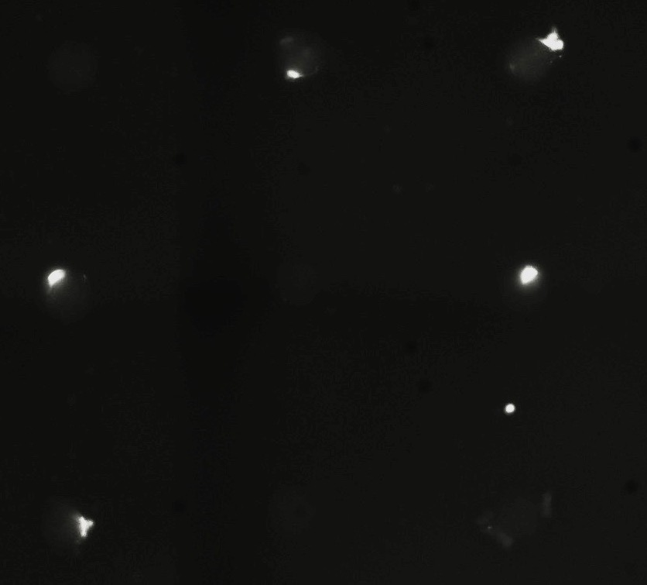

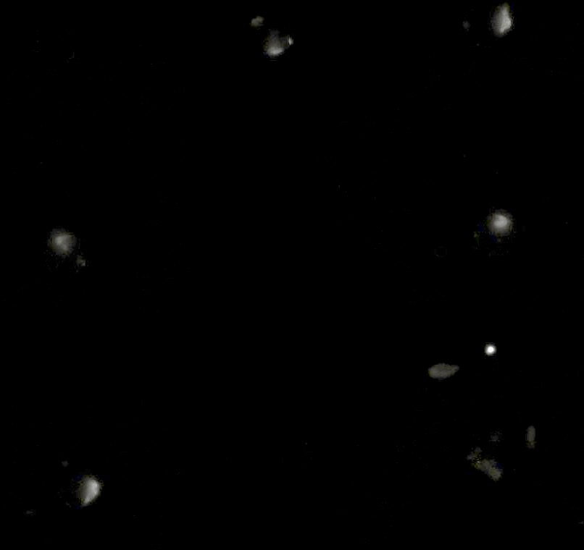
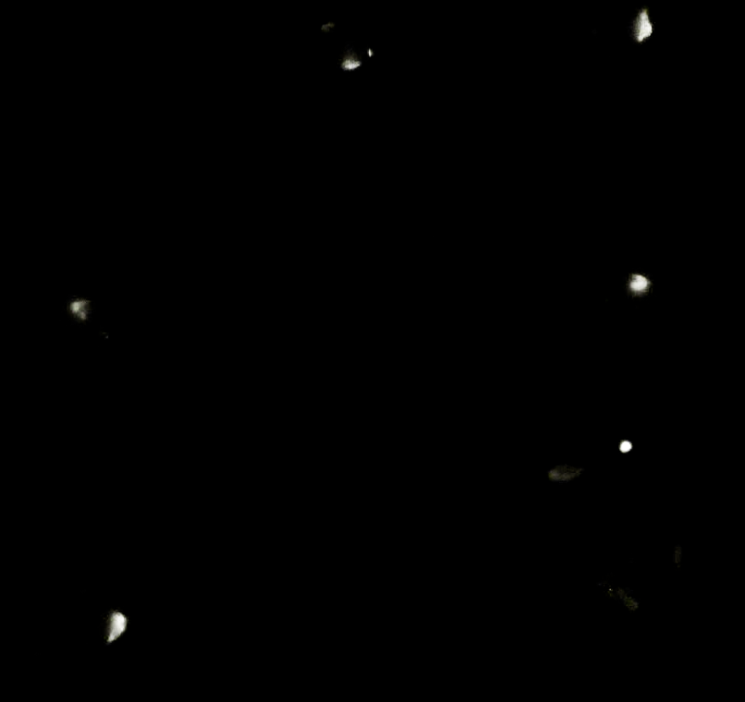
MSC grown in 60 mm pores
(a)
Day 0
Day 3
Day 5
(b)
(c)

Slide 15
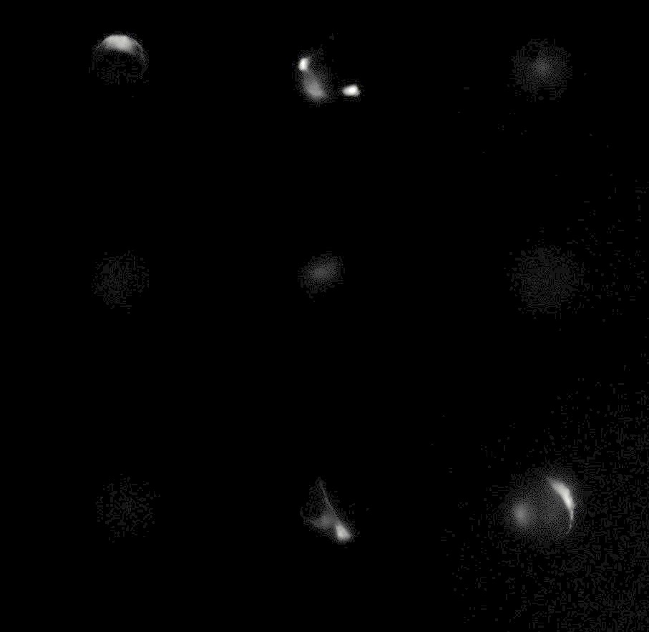
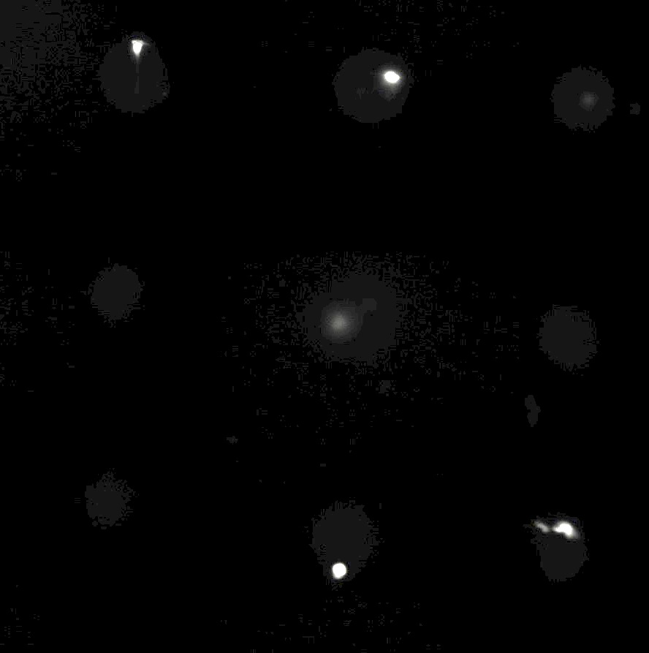
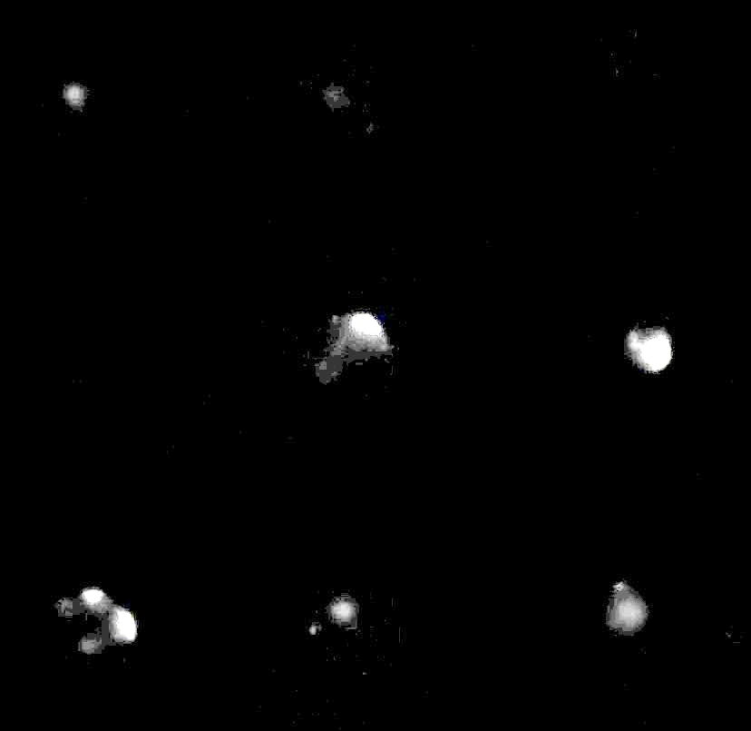
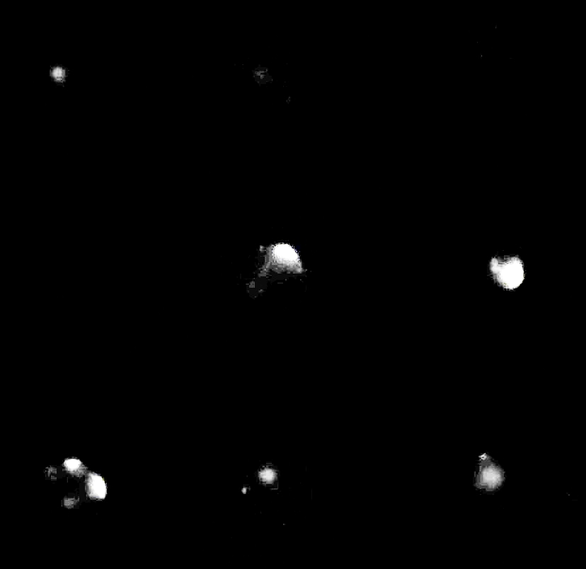

MSC grown in 100 μm pores
(a)
Day 0
Day 3
Day 5
(b)
(c)

Slide 16


Conclusion
We also observe the cell cycle arrest of mesenchymal stem cells in spherical microwell arrays.
It is possible to use the new protocol to replace the old method.

Slide 17
Questions?

Slide 18
Thank you!

